Slide 1
Dealing with sensitive data in support
Applitools Support - September, 2023
Notes:
Hello world

Slide 2
What is considered sensitive information?

Slide 3
Customer Code
Customer code can contain potentially sensitive information, including but not limited to:
1. Keys
2. Proprietary information
3. Information about future company products
4. Usernames/Passwords Don’t share customer code unless absolutely necessary.

Slide 4
Customer Code
Do not: 1. Post code with proprietary information on Slack or email code to anyone that wasn’t an original recipient. 2. Use external tools that accept code as input with customer code.

Slide 5
Remove sensitive data from code before sharing
When sharing code, you should obfuscate (substituting sensitive strings with a placeholder).
const apiKey = "ACTUAL_KEY"; const username = "ACTUAL_USERNAME"; const password = "ACTUAL_PASSWORD";
test(‘super secret project’, async ({page}) => { await page.goto(“supersecret.demo.com”); await eyes.check( “supersecretpage”, Target.window.fully() ); });
const apiKey = "FAKE_API_KEY"; const username = "FAKE_USERNAME"; const password = "FAKE_PASSWORD";
test(‘fake_test_name’, async ({page}) => { await page.goto(“fakeURL”); await eyes.check( “fakepage”, Target.window.fully() ); });

Slide 6
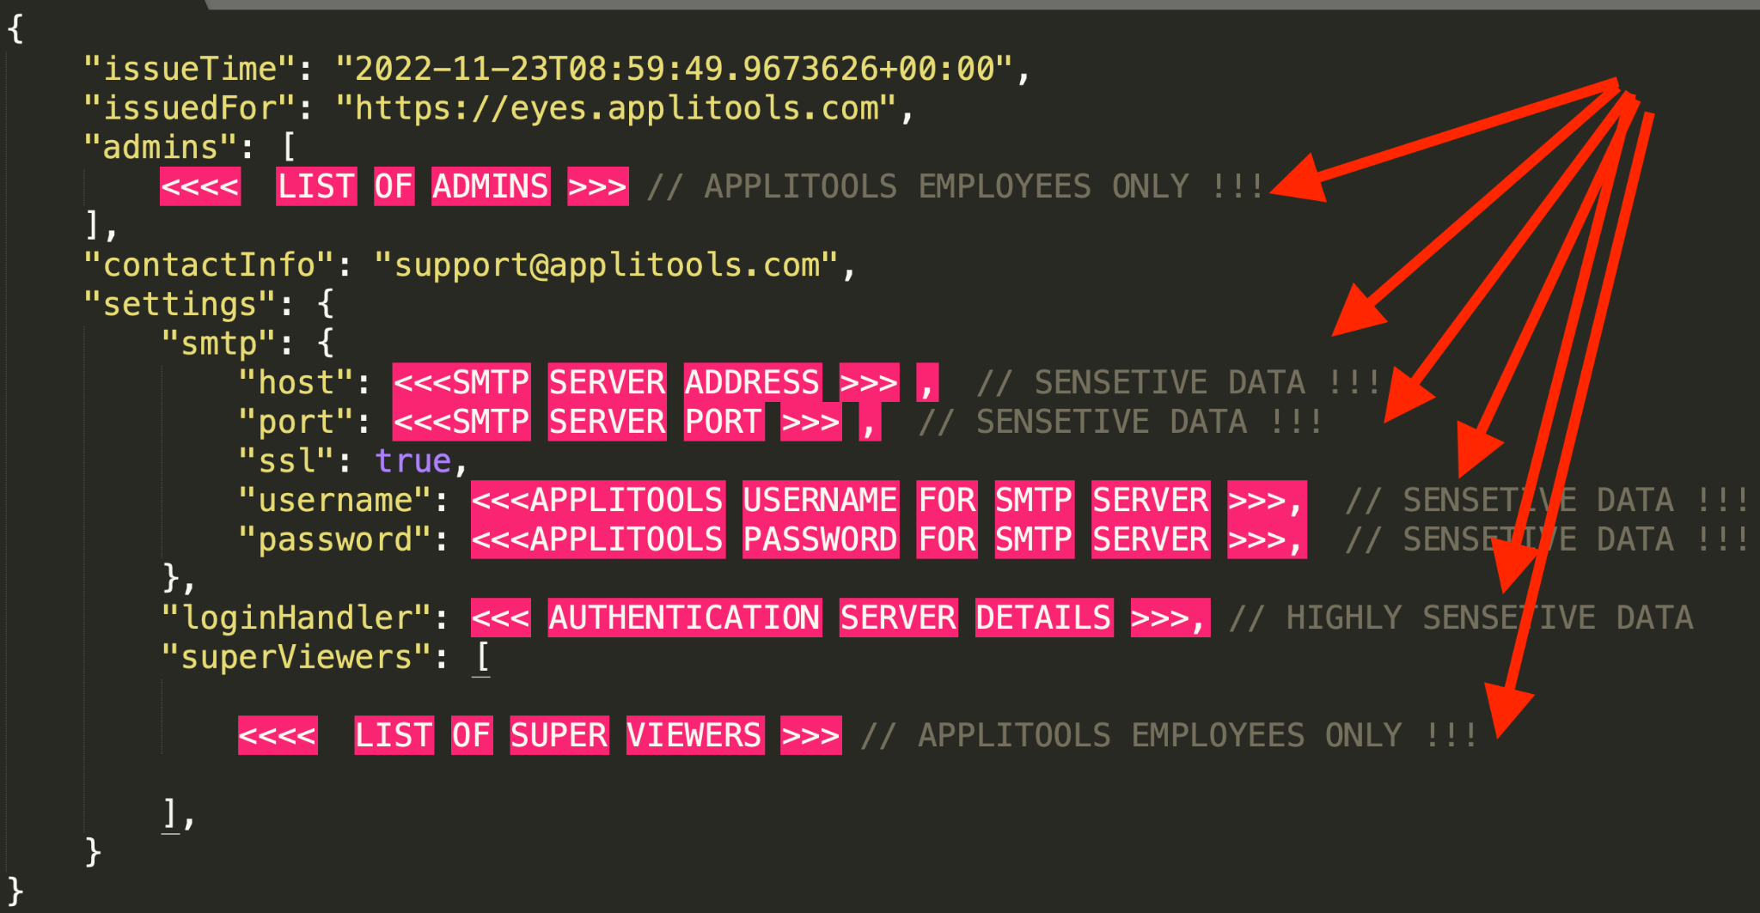
Cloud Configurations Structure - HIGHLY Sensitive
All Eyes Clouds (Public, Dedicated, Onprem), requires access to different services to operate among them, Authentication and SMTP servers. The Configuration file of each cloud contains highly sensitive data visible only to Super Admins (see image on the right). Do NOT share/copy or store this information.
New configurations can only be pushed to the cloud in an encrypted form.

Slide 7
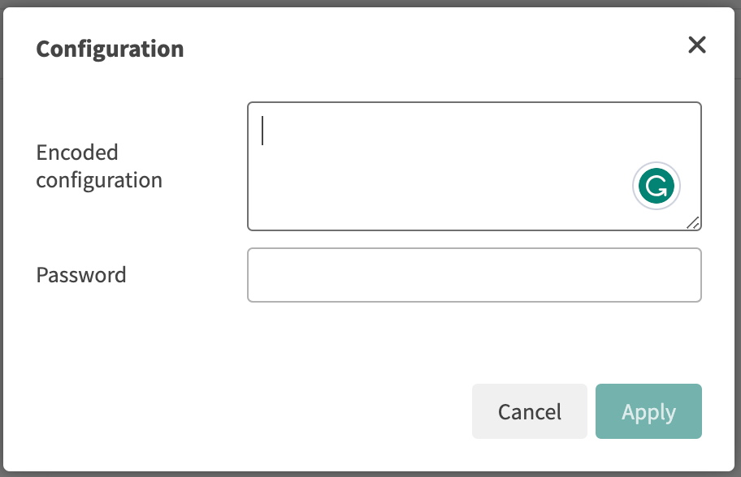
Cloud Configurations Structure - HIGHLY Sensitive
Pushing new configurations to clouds can be done only after being encoded. Creating Configuration elements is done only by: Applitools CTO - Adam Carmi
Head of Backend team - Yotam Madem
VP Customer Success and Support - Yarden Naveh
Support EMEA team lead - Liran Barokas
Support US team lead - Chris Allulis

Slide 8
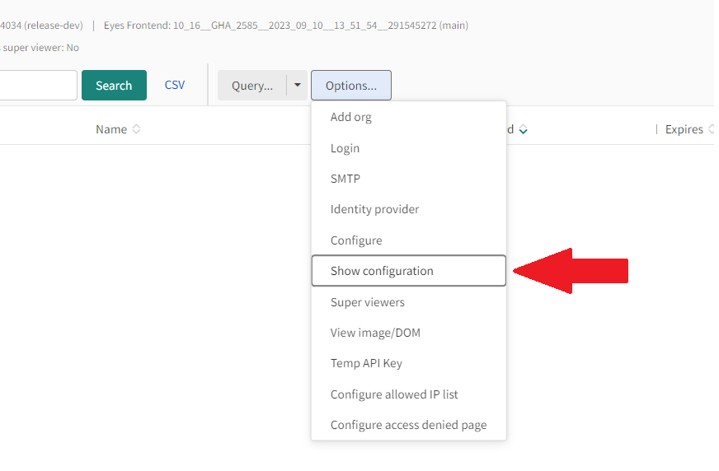
Cloud Configurations - Highly Sensitive
SSO Configurations obtained through BackOffice contain keys and passwords and other sensitive data.
In the rare circumstances where it’s necessary to share these configurations internally (for example, if there is a backend issue that requires R&D support), ensure that all sensitive data (e.g. keys, passwords) are removed.

Slide 9
On-prem configuration files
On-premise server configuration files contain potentially sensitive information, including but not limited to: 1. Security headers 2. Backup encryption keys The same principles for sharing files containing sensitive data are applicable to on-prem files.

Slide 10
SSO Passwords
When a customer has an issue that requires access to an SSO enabled private cloud, agents should submit an email request to Adam Carmi. Adam will send the SSO password over Slack. As soon as the agent has this password stored in a secure password manager, they should notify Adam, so that he can delete the message. Passwords are meant for the recipient, and should not be shared.

Slide 11
Guidelines on storing sensitive information
For continued investigation, it will be necessary to have sensitive information like SSO passwords available to the agent they’ve been granted to. Private information should never be stored anywhere connected to the internet. Passwords should be stored using a secure password manager. Do not store information in: 1. apps that communicate over the internet. 2. LocalStorage 3. Slack 4. browser

Slide 12
Internal Data
Potentially sensitive internal knowledge (account information, future products) should only be shared with those that need to know that information until that information becomes widely available.

Slide 13
Handling sensitive information in various apps

Slide 14
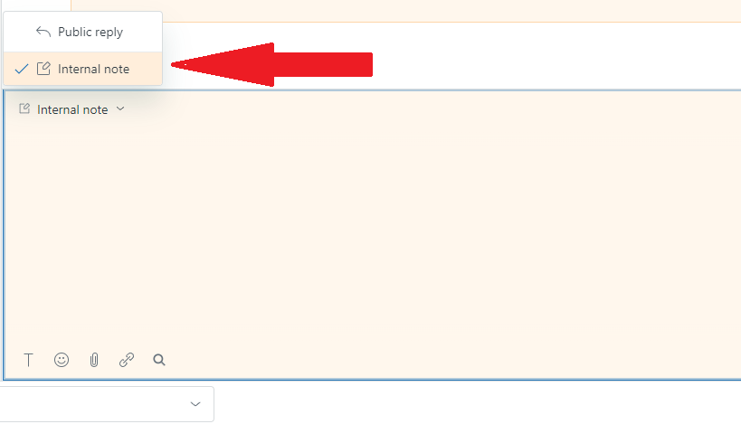
Zendesk
It is often useful to add internal notes to Zendesk tickets. We do this to communicate internally with colleagues, and to add additional context to a ticket issue to assist in solving similar issues in the future. Sensitive information should never be posted to Zendesk.
Once information is added to a Zendesk ticket, there is no way to edit or delete the data, and will exist on Zendesk servers in perpetuity.

Slide 15
Zendesk
Ensure that any information you send to Zendesk does not contain:
1. Secret Keys
2. Passwords
3. API keys
4. Non-obfuscated customer information (e.g. product names)
If it is unclear whether information can be safely sent to Zendesk: 1. Ask your manager if that data can be safely posted, or 2. Opt not to post that data at all

Slide 16

Slack
It is oftentimes necessary to share information over Slack with colleagues.
If any sensitive information is required to be sent, it should be acknowledged by the receiver as soon as possible, and immediately deleted.

Slide 17

Email
When dealing with sensitive information through email, it is a best-practice to share information with the least number of recipients required. If a thread contains sensitive information, do not add anyone else to the thread unless they absolutely need to have the conversation context.

Slide 18
Email
Email is an insecure medium for transmitting sensitive information. Email has many threat vectors, including but not limited to: 1. Storage of email data on servers 2. Lack of default end-to-end encryption through traditional email protocols (SMTP, IMAP, POP3) 3. Lack of native validation of sender identity.

Slide 19

Other services (GPT and online tools)
You should assume that all online tools are collecting any data that you send.
If you would like guidance from an online tool (e.g. ChatGPT), all sensitive information (including unique strings) should be obfuscated.
Never trust a tool that hasn't been internally verified.

Slide 20

Zoom
Be mindful of sharing your screen in Zoom sessions.
External people (customers/vendors) should never see:
1. Slack conversations
2. Email
3. Code that is not customer facing
4. Usage reports or any other internal information
This is also true for internal communications. All internal information is on a need-to-know basis.

Slide 21
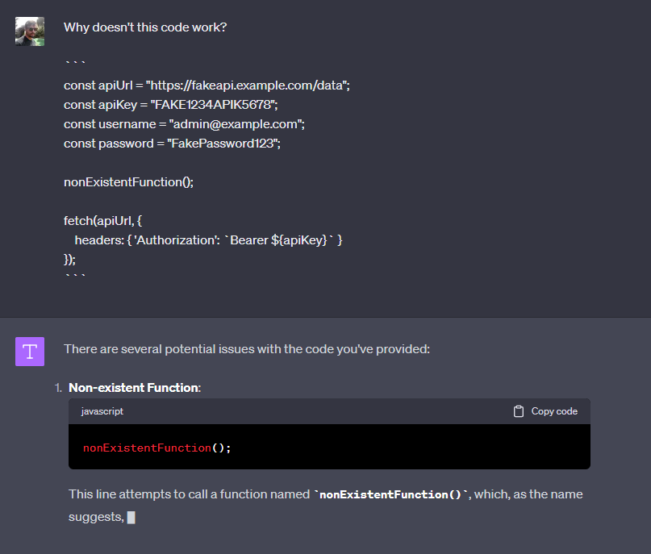
Other services (GPT and online tools)
In this example, unique strings are obfuscated and can’t possibly be traced back to any existing codebase.

Slide 22
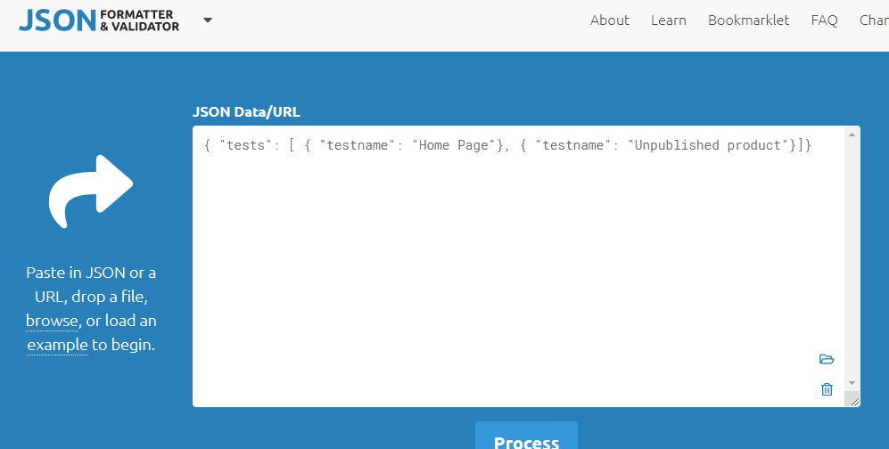
Other services (GPT and online tools)
Always assume that any data sent to online tools will be kept in their databases.

Slide 23
General Principles
Principle of least privilege: information should only be shared and available to those who require it to perform their job.
Sensitive data should never be submitted to servers that can store that data on their own servers, including but not limited to: Zendesk, Slack.
If sensitive information must be sent through Slack, the message should be deleted as soon as possible.
If you are unsure of how to handle certain data, consult with your manager, infosec, or company leadership.

Slide 24
Key Takeaways
In case of a security incident of any kind you are obliged to inform in writing ASAP the following members:
Your Direct Manager
Applitools CISO (Denis.styrt@applitools.com)
Applitools CTO (Adam.Carmi@applitools.com)
Share a detailed description of the incident
Address the mitigation of the incident with the highest priority

